Slide 1







A
R
re
omantic
C
D
?
omedies
ead
Naren Prakash, Fathima Shaikh, Caleb Williams

Slide 2

Research Questions
How are we comparing rom-coms across different eras?
Are recent romantic comedies more correlated with each other than those of the past?
Have romantic comedy scripts become less complex (in terms of vocabulary)?
Can the era of a romantic comedy be easily predicted based on aspects of the script?

Slide 3

A
genda
Cleaning, Data Overview, and Word-Based Analysis
Sentiment Analysis and Clustering
Topic Modeling, LLM Integration, Prediction, and Results

Slide 4

Data cleaning, EDA and Word-based Analysis
Notes:
To begin our project, we started by cleaning the data and performing exploratory word-based analyses.

Slide 5
C
leaning the Data
Removed common English names using genderdata package
Removed punctuation, special characters
Set everything to lowercase
Removed English Stopwords
Removed all whitespace
Specific transformations, like “mmyydd” to a space
Stemmed all words
Removed sparse terms
Notes:
To clean the data, we first used a dataset from the genderdata package, to remove common English names (because we realized early on that rom-coms use a lot of names)
Next, we did standard tm data cleaning
– so removing punct, special chars, setting to lowercase, removing stopwords, whitespace, and doing transformations like getting rid of month, year, day
word stemming and removing sparse terms

Slide 6




35162/122068
Non-/sparse entries
78%
Sparsity
14
Maximal term length
Notes:
Here’s an overview of what our data looked like after cleaning

Slide 7
D
ata handling
tidy format
with count
tidy with count + tf-idf columns
bind_tf_idf
Cleaned data
unnnest _tokens,
count
cast_dtm
DTM/DFM
Notes:
Next, with our cleaned data, we tokenized to make a tidy format and added a count.
From there we converted to essentially two formats–DTM and DFM, and tidy with tf-idf calculations–which we could then use for all of our analysis and modeling

Slide 8
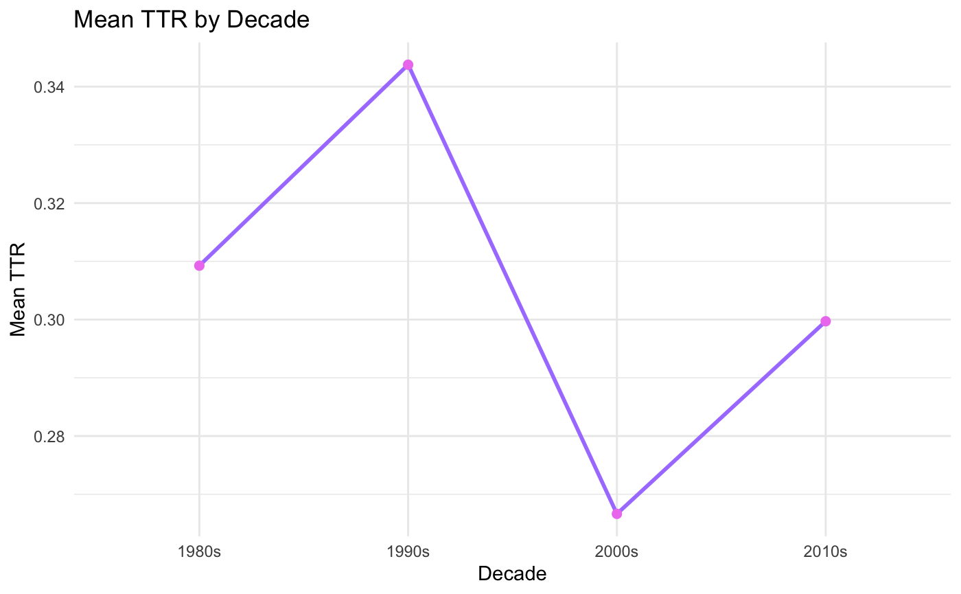
How lexically diverse is each decade?
Notes:
The first step to our EDA was exploring how the lexical diversity of rom-coms varied across decades.
((using quanteda’s textstat_lexdiv() function on our DFM, we first calculated the TTR for each rom-com. Then calculated the mean TTR for each decade ))
As you can see, it would appear that the 90s have a higher mean TTR while the 2000s have a lower mean TTR relative to the 80s and 2010s.
But is this variation actually significant?

Slide 9
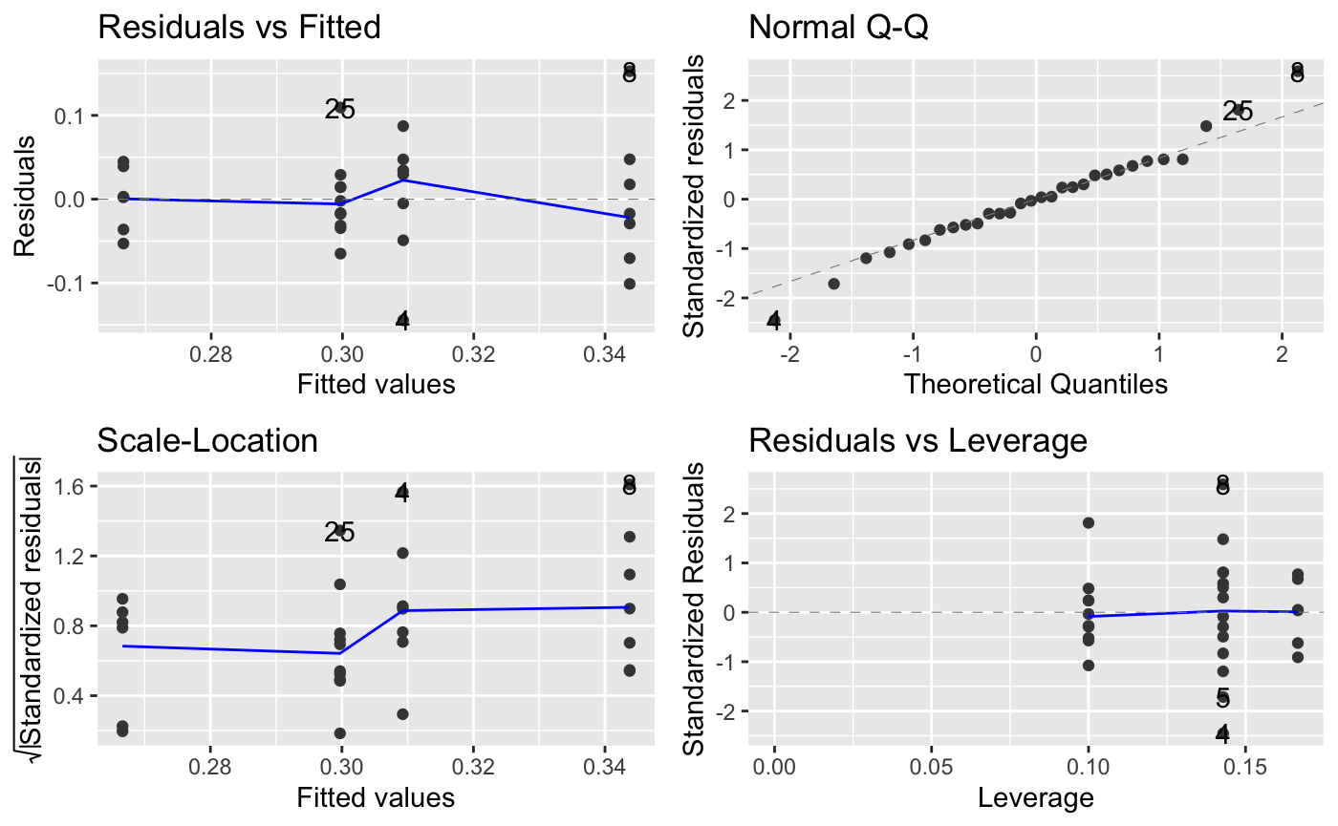
Are these differences significant?
Coefficients | Estimate | Std. Error | t value | Pr(>|t|)
Intercept | 0.309252 | 0.024055 | 12.856 | 8.96e-13
decade1990s | 0.034504 | 0.034019 | 1.014 | 0.320
decade2000s | -0.042619 | 0.035408 | -1.204 | 0.240
decade2010s | -0.009545 | 0.031364 | -0.304 | 0.763
Multiple R Squared | Adjusted R Squared | F-Statistic | p-value
0.1579 | 0.0607 | 1.625 (3 and 26 DF) | 0.2078
Notes:
To test this, we created a simple linear model. As you can see, none of the predictors are significant, and overall the model itself is not significant
indicating that each decade’s Mean TTR are, in fact, NOT statistically different. We can interpret this as meaning there is no real change in the lexical diversity across decades.
(And we can see our plots on the right, showing that our linearity assumptions are not violated, so we can be confident in our anova’s result)

Slide 10
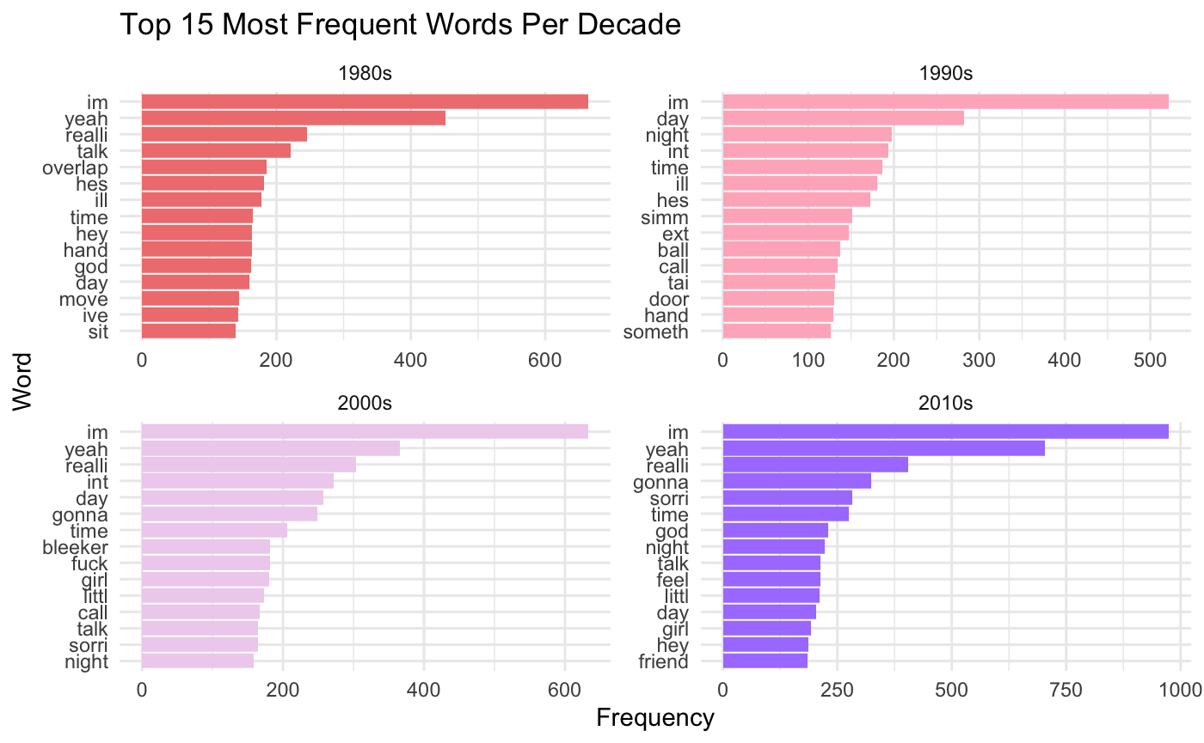
What words appear most in each decade?
Notes:
Next, we looked at common words in each decade.
Right away, its obvious that there are a lot of shared words.
For instance: “I’m” is the most common word in all of the decades, followed by “yeah” (in all except the 90s).
Other shared common words include really, time, day, night, talk, gonna

Slide 11
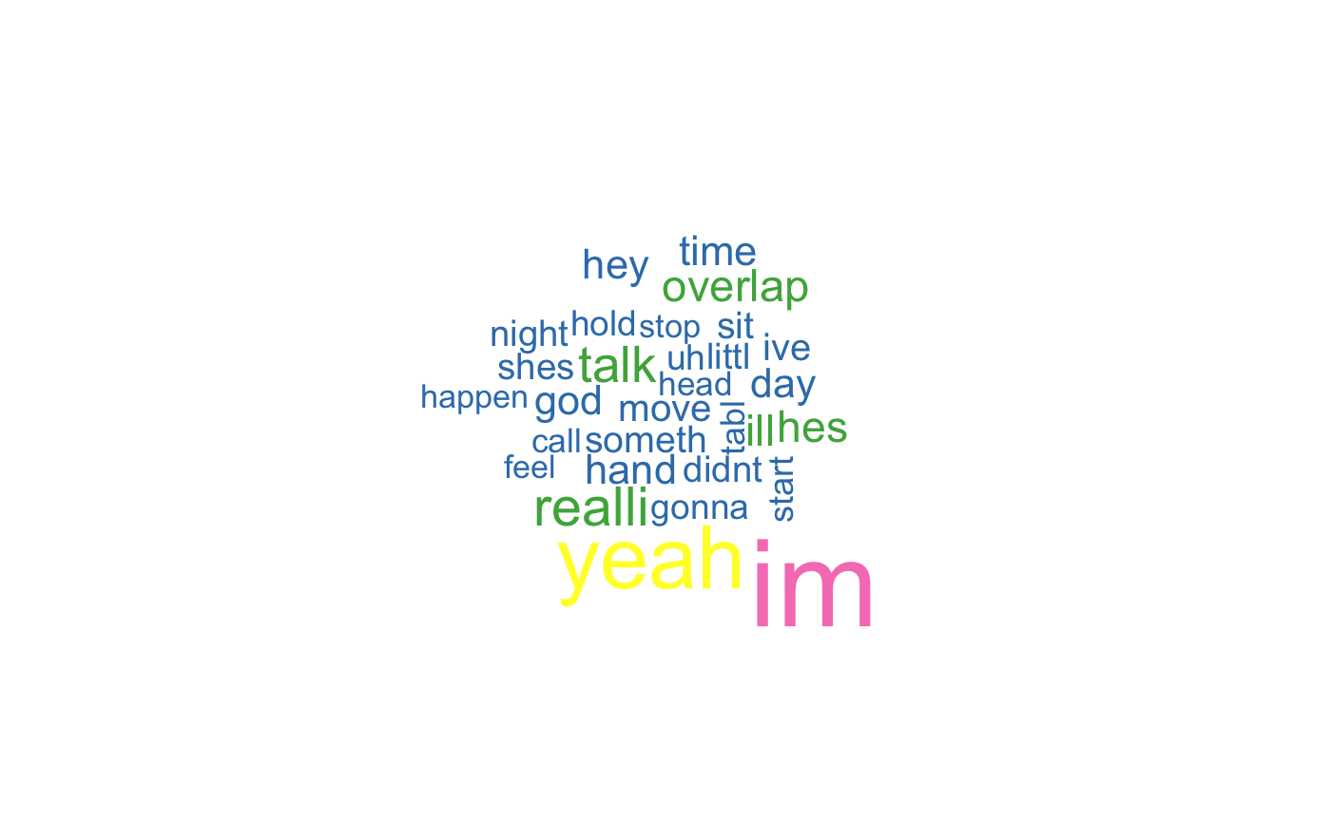
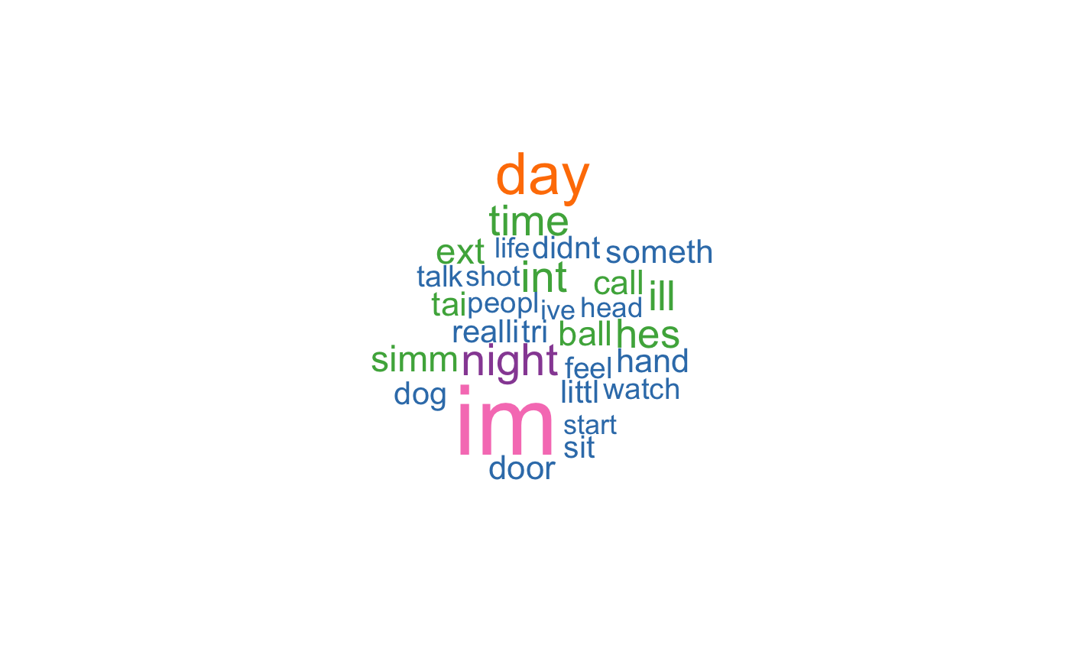
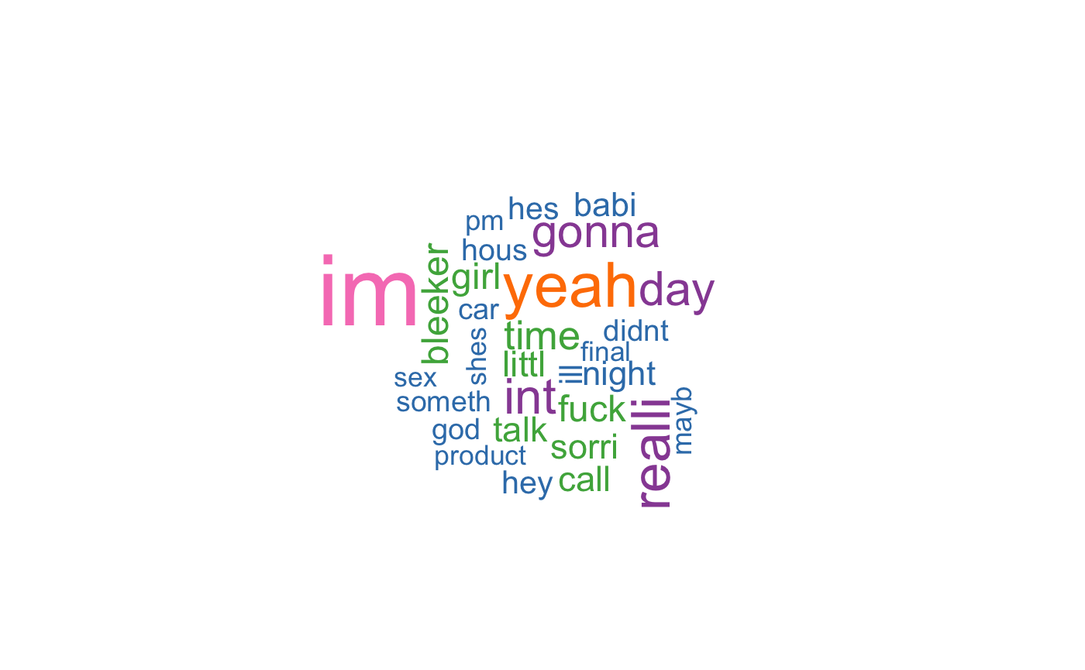
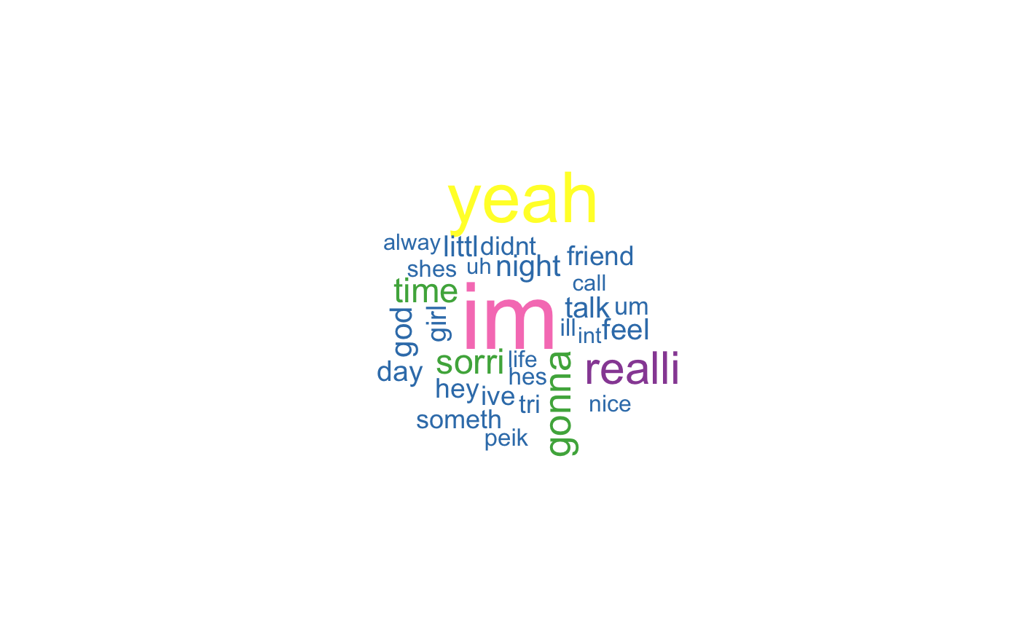
1980s
1990s
2000s
2010s
Notes:
Here is the same data, visualized as word-clouds, and, again, its really easy to see just how similar each decades’ common words are.
This overlap of the most common words in each decade supports what we found with lexical diversity – so far, despite being from different eras, it seems that the language of the rom-coms appears to remain very similar

Slide 12
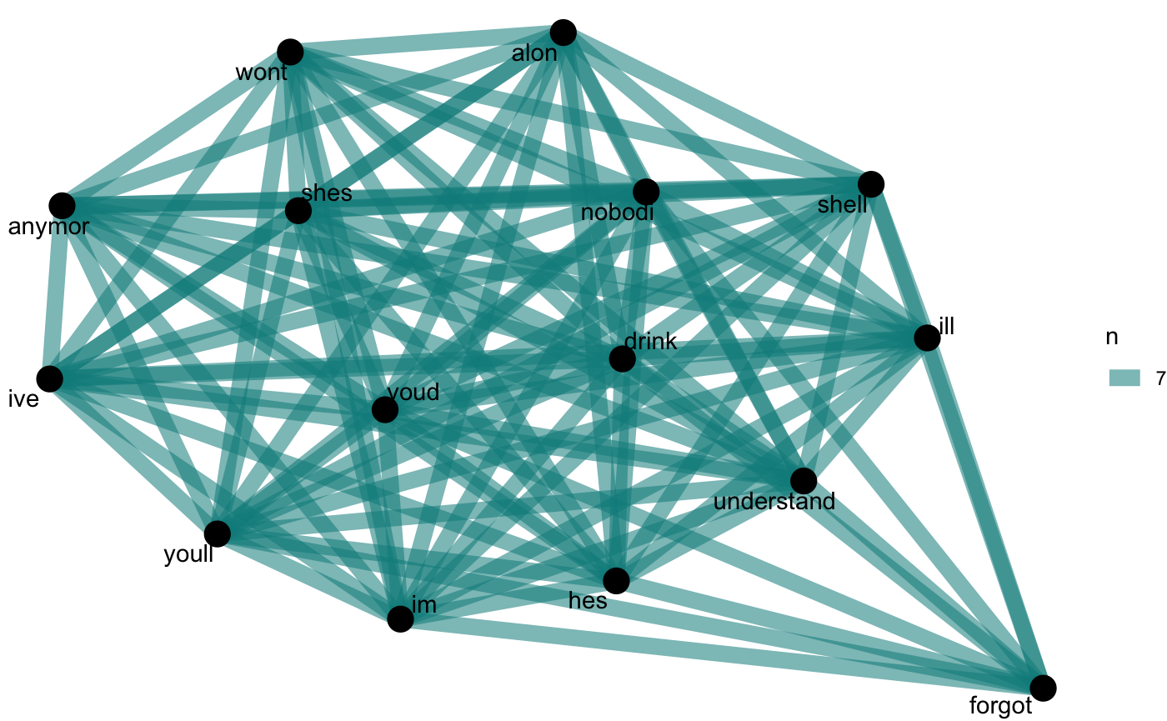
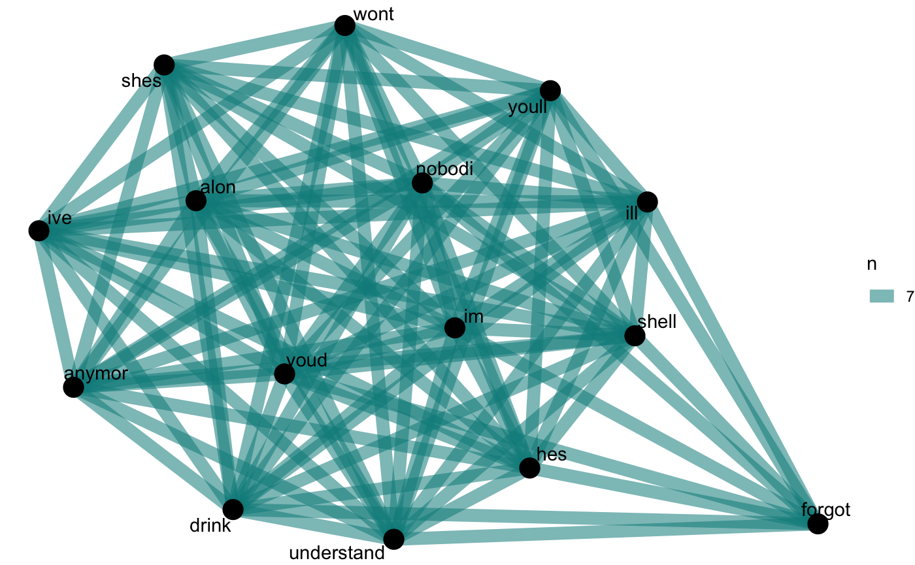
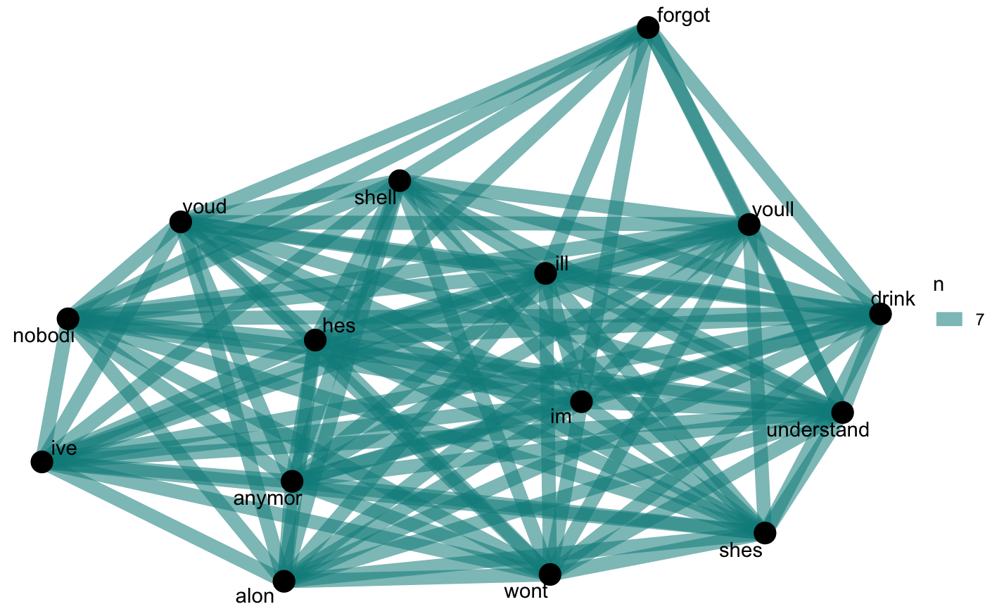
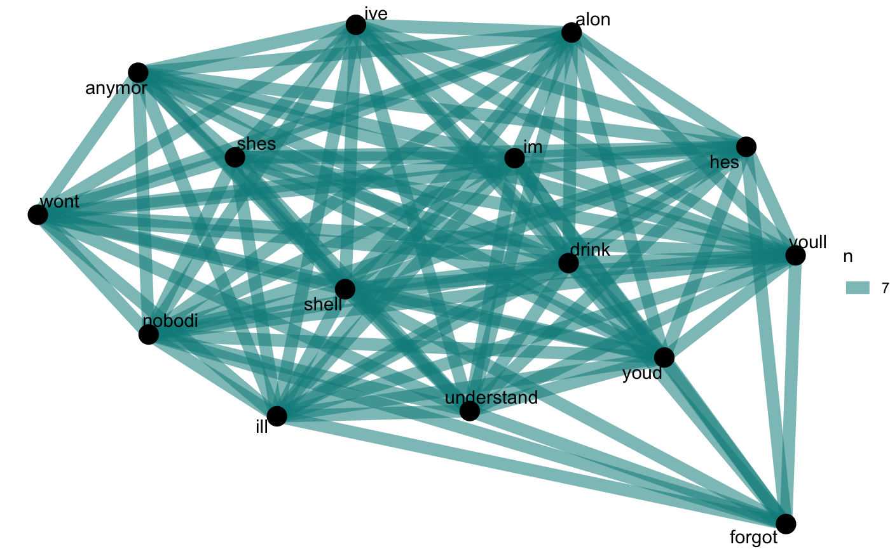
Word co-occurrences by decade
1980s
1990s
2000s
2010s
Notes:
We also looked at word-co occurrences by decade, using widyr’s pairwise_count() function to look at the most common word pairs. The result is very similar to what we saw with single words: each decade has nearly the same set of words as one another and the patterns are extremely similar, again suggesting that each decade are not varying greatly in text content.

Slide 13
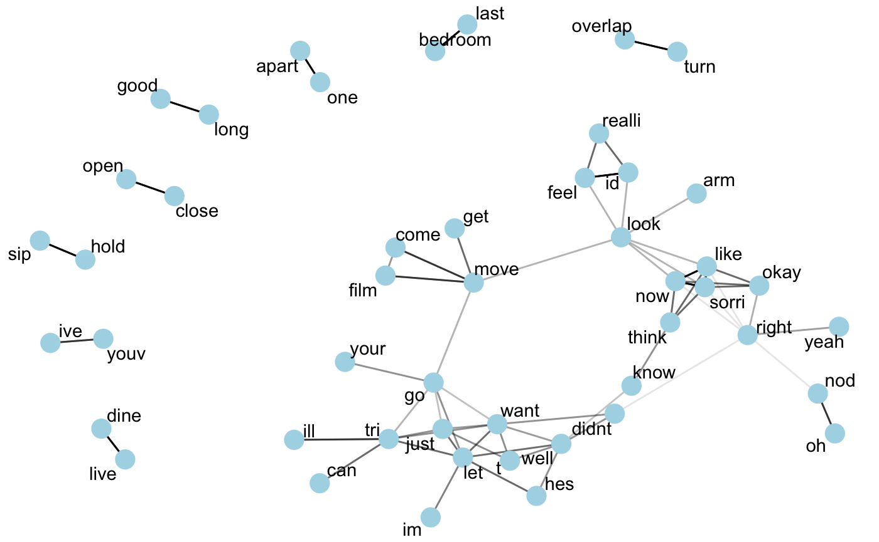
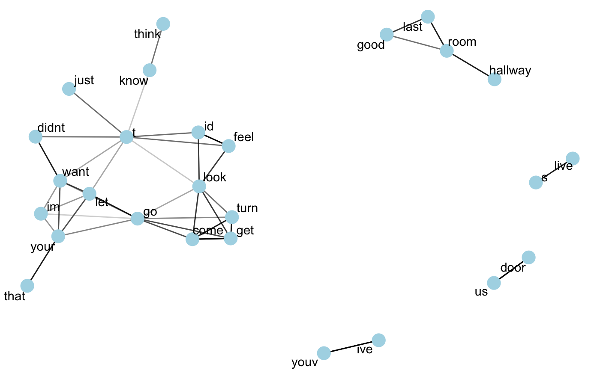
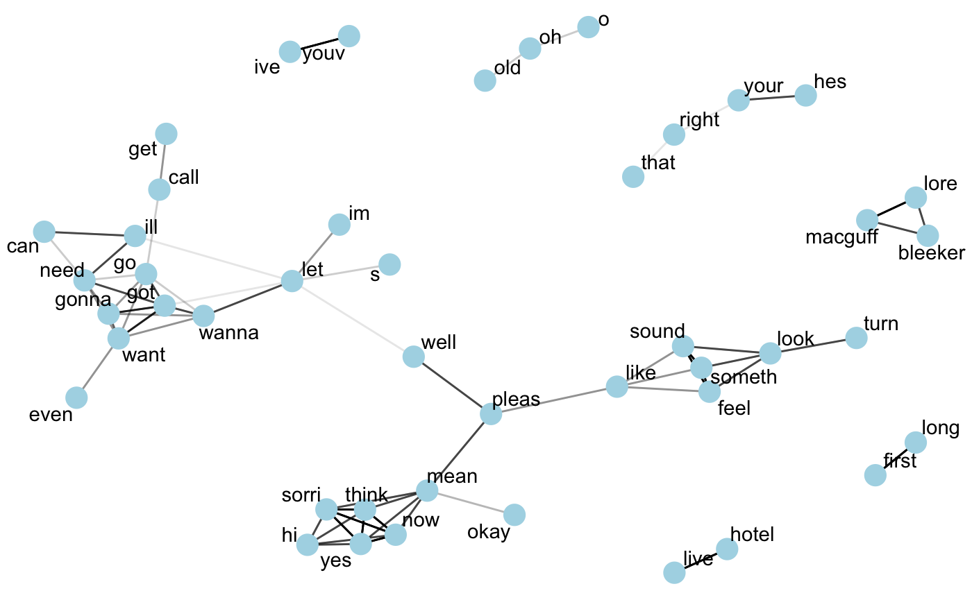
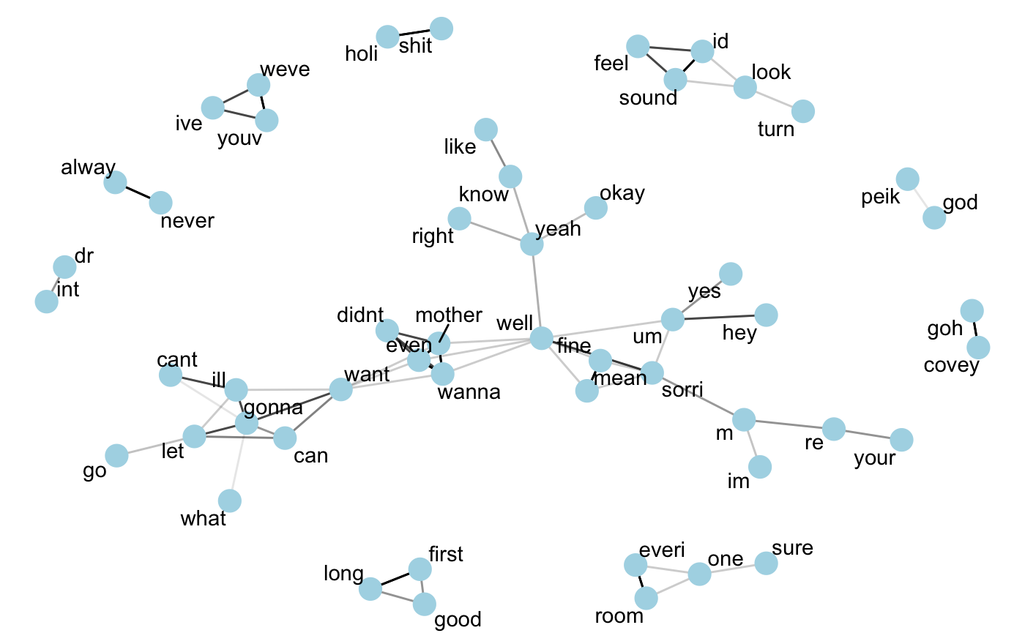
Correlation analysis with bigrams
1980s
1990s
2000s
2010s
Notes:
Looking at the bigrams (so similar to co-occurence but slightly different as we are looking at words that follow one another in a sequence) of words within each decade, we see DO see different patterns between decades.

Slide 14
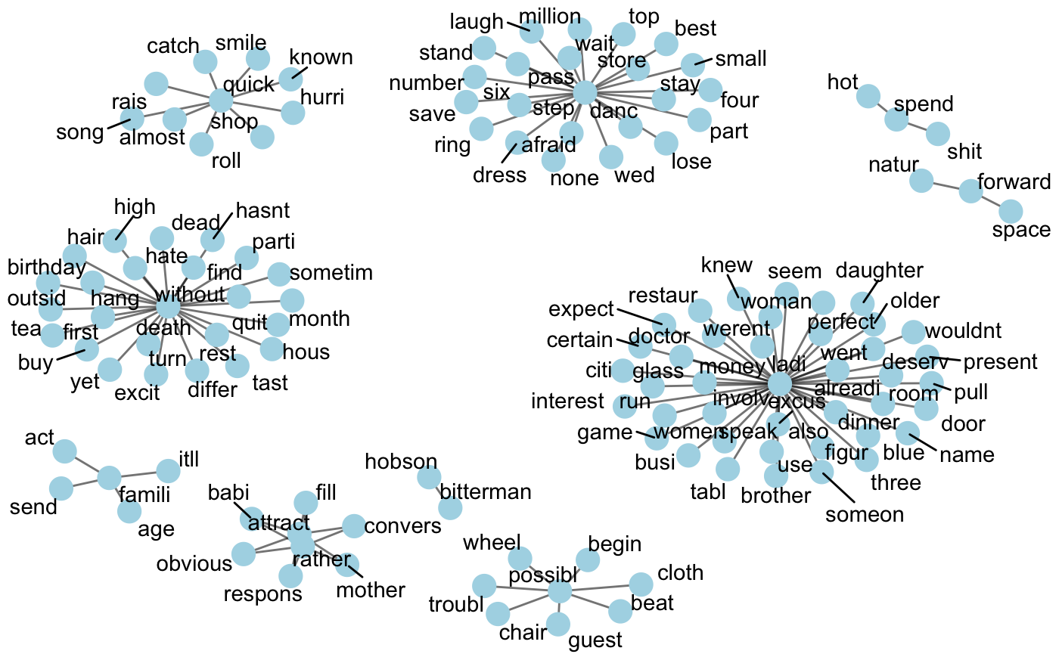
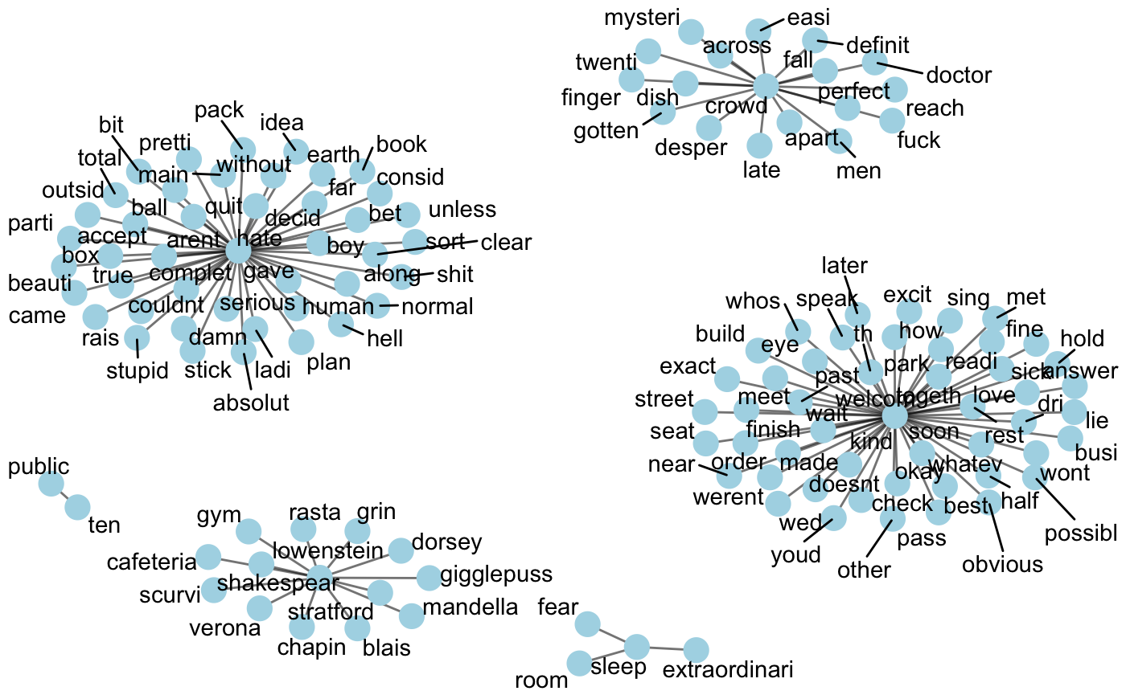
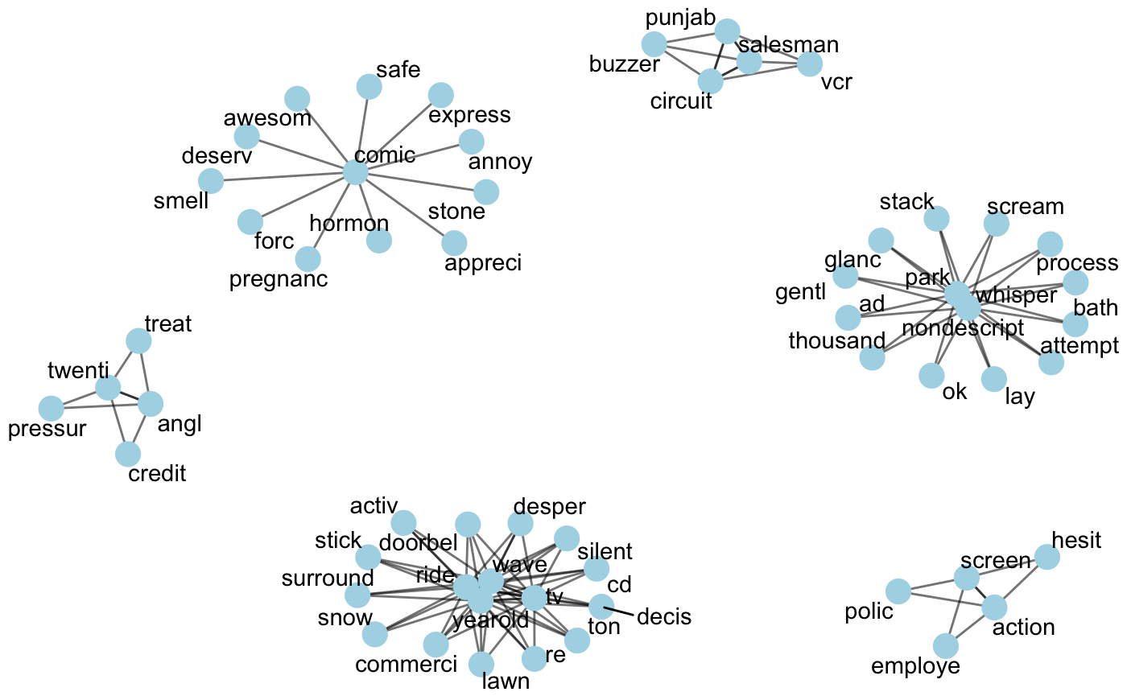
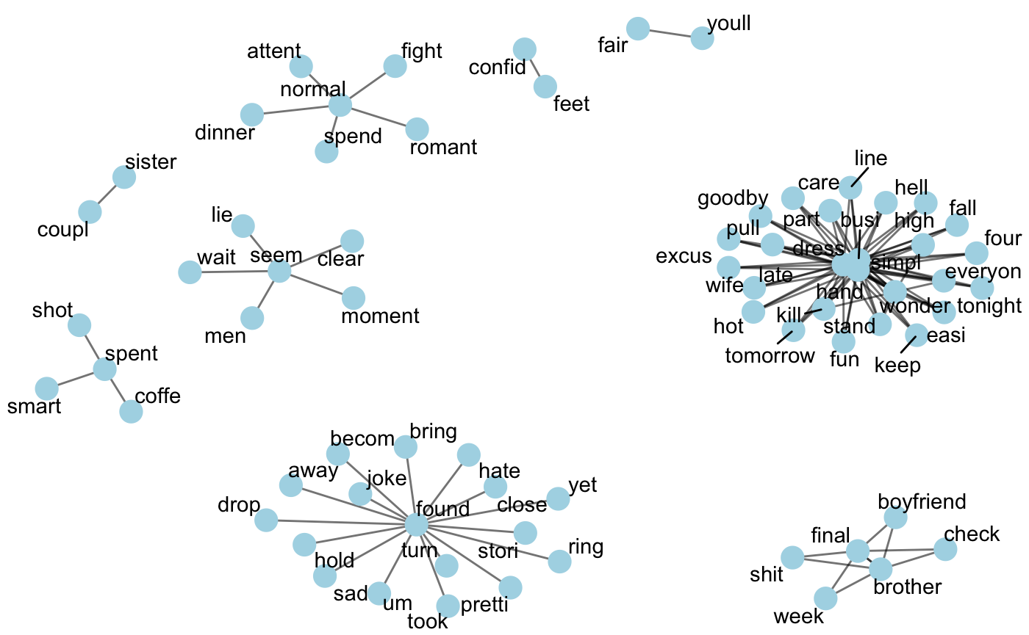
Correlation analysis with trigrams
1980s
1990s
2000s
2010s
Notes:
We also see differences in patterns in the trigrams.
From this we can gather that there is definitely variety in word sequences (so which words are likely to follow others – or how words are used together) between decades, though the overall words used (that we saw with TTR, common words, and co-occurrences) are not so diverse.
So looking at these, we thought there might also be sentiment division across decades.

Slide 15


Sentiment Analysis and Clustering

Slide 16
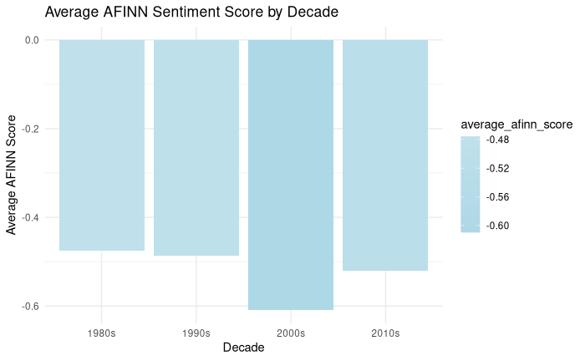
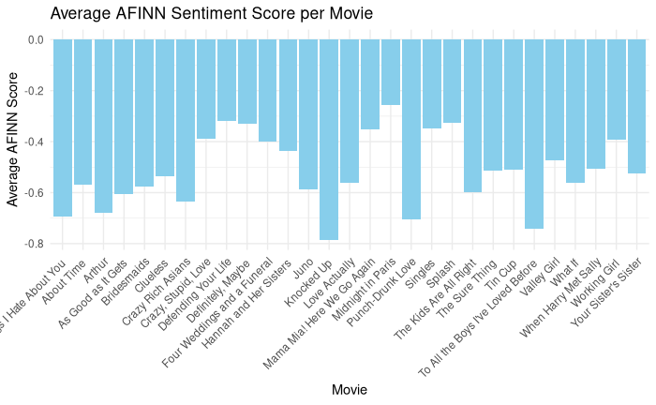
H
ow Does Emotional Tone Change Across Decades?
Notes:
All movies have a negative average afinn sentiment score. The graph on the right shows average score by decade, and movies from the 2000s seem to have the most negative average score.

Slide 17
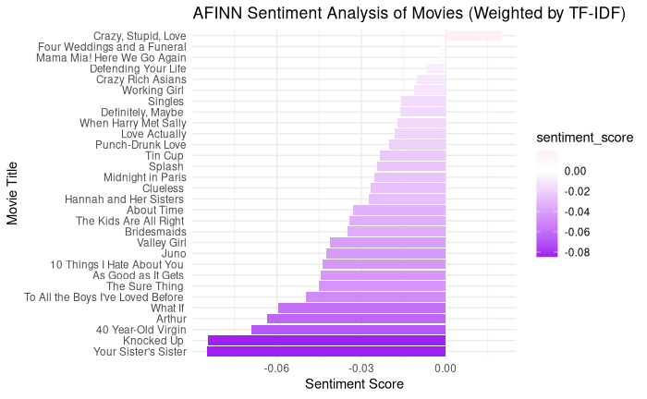
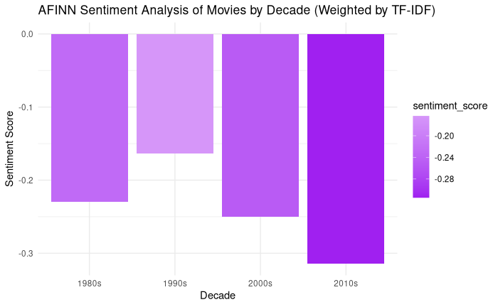
A
re the sentiments of common words changing over time?
Notes:
This graph shows the afinn sentiment analysis by tf idf. Here you can see that most sentiment scores are negative, and by decade, all but movies from the 1990s have negative scores based on tfidf.

Slide 18
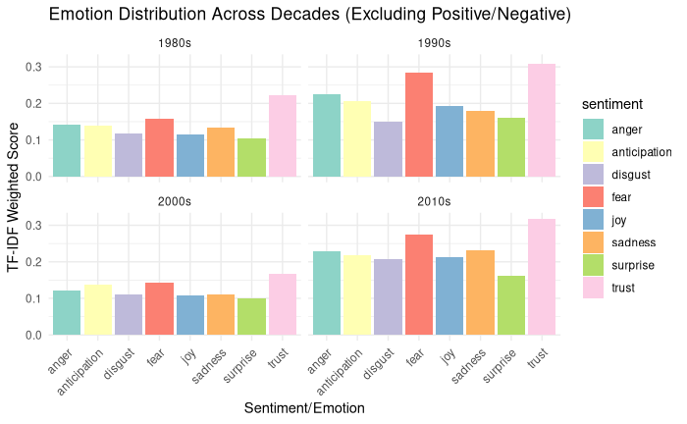
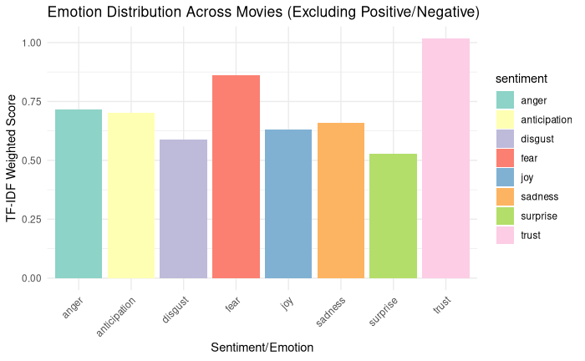

W
hich emotions dominate, and how do they change over time?
Notes:
Trust and fear are the top 2 most common emotions in rom coms, based on their weighted tf idf score. This pattern of trust and fear being the most common remains the same throughout the decades,

Slide 19
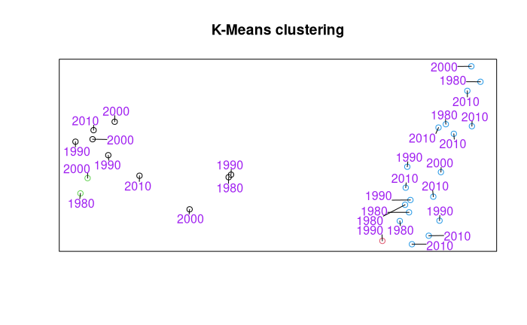
Can we separate the movies by decade?
Notes:
projected on a 2 d surface for plotting reasons

Slide 20
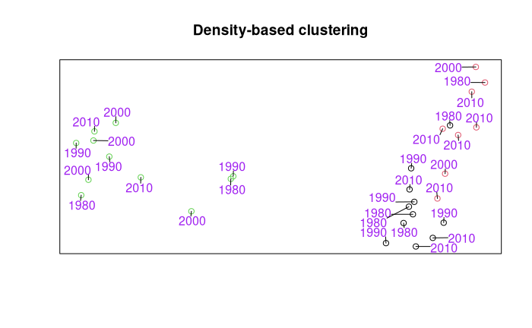
Can we separate the movies by decade?

Slide 21
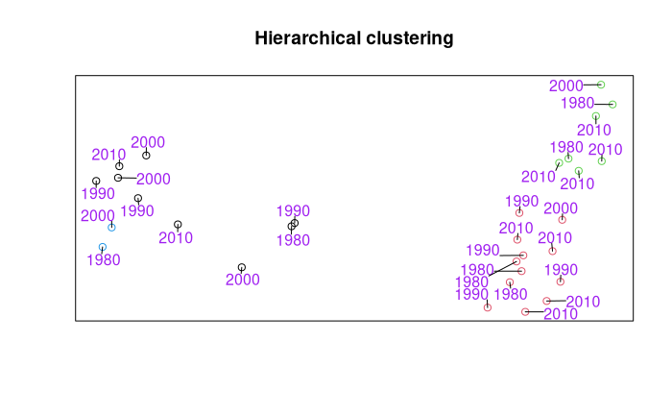
Can we separate the movies by decade?

Slide 22


Topic Modeling, LLM Integration, and Prediction

Slide 23
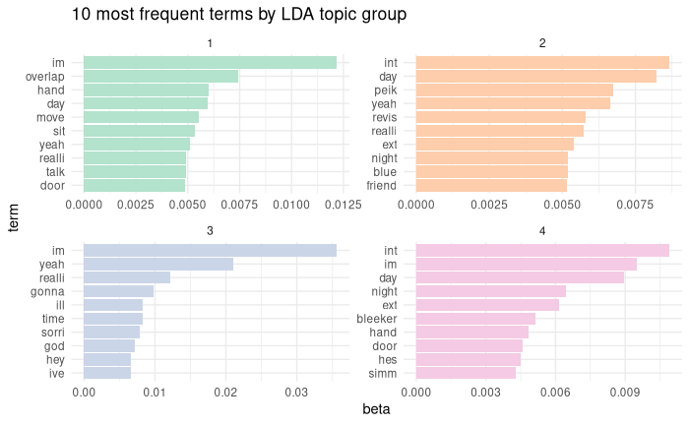
What are the most popular terms in each topic group?

Slide 24
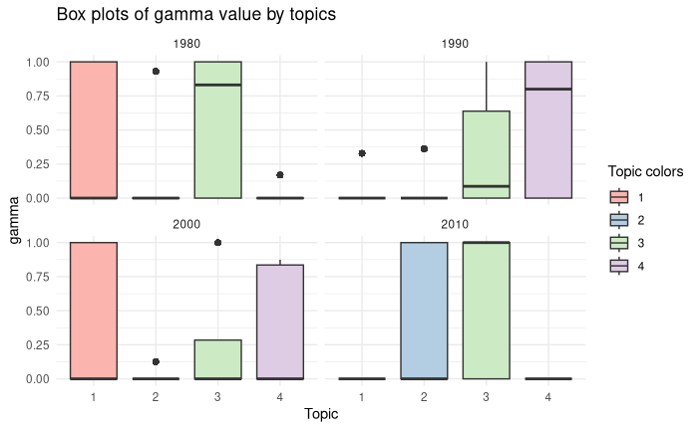
D
o our topics correspond with our decade splits?

Slide 25
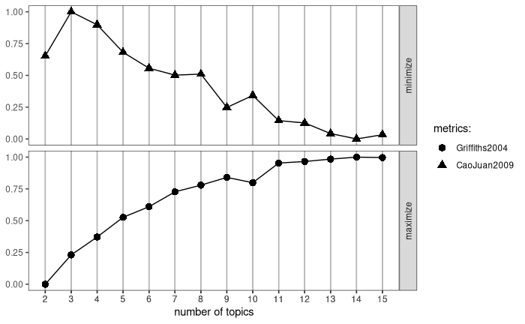
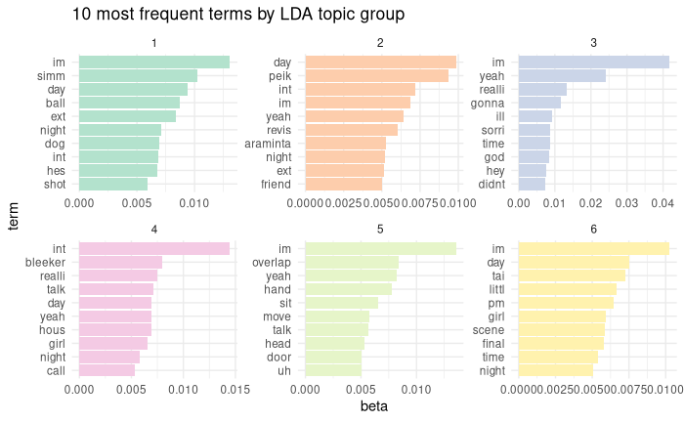
What are the true topics found in the data?

Slide 26
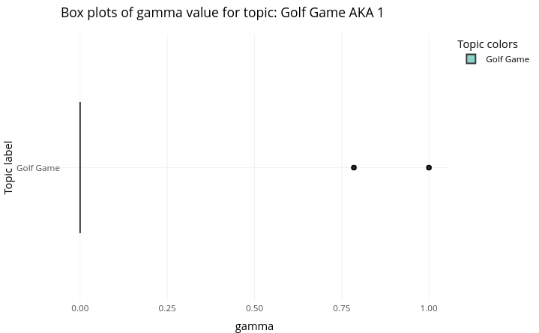
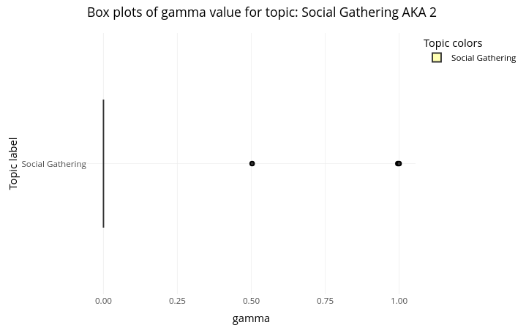
How are documents associated with these topics (labeled by ChatGPT)?

Slide 27
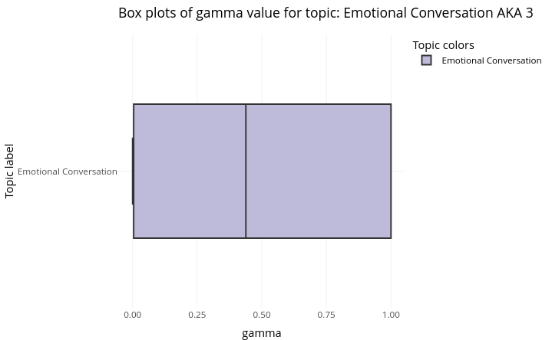
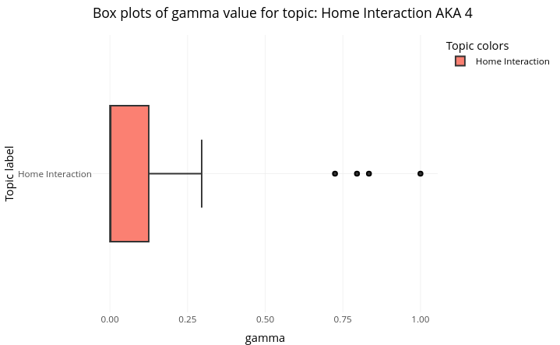
How are documents associated with these topics (labeled by ChatGPT)?

Slide 28
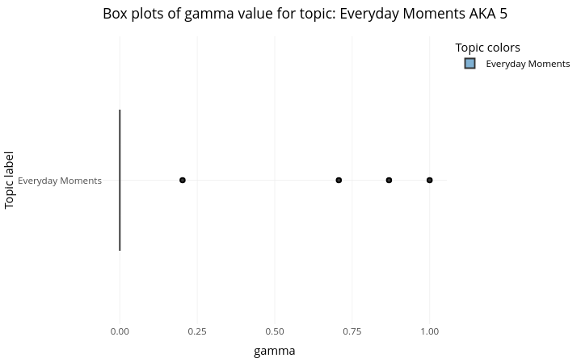
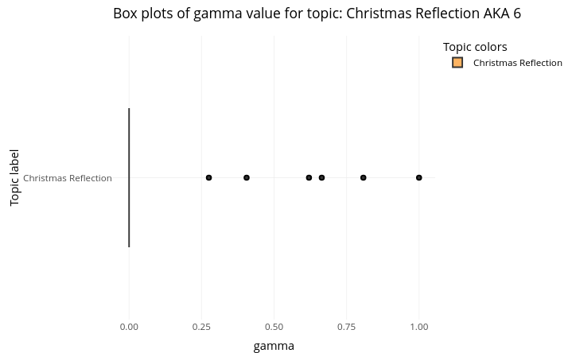
How are documents associated with these topics (labeled by ChatGPT)?

Slide 29
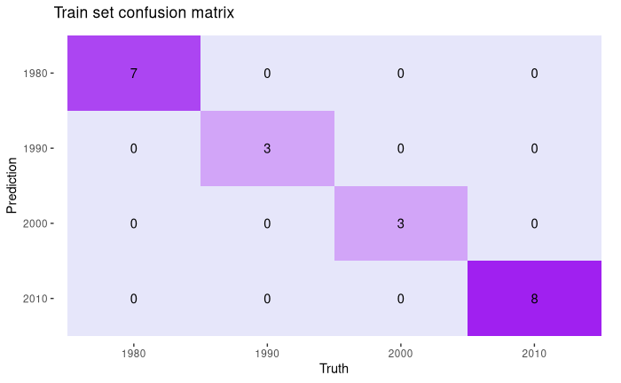
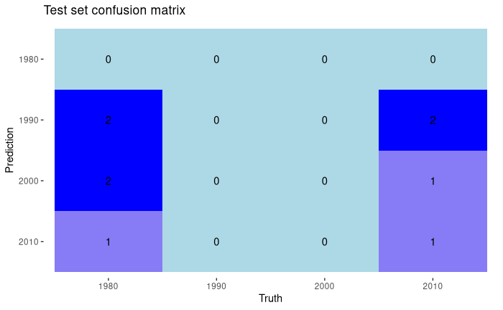
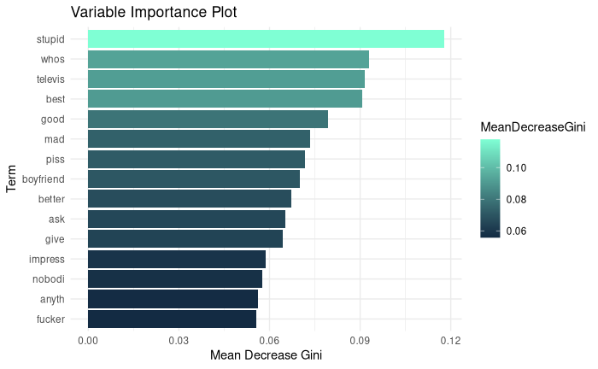
Can we predict the decade of a rom-com from its text? (RF)
Accuracy: 100%
Accuracy: 11.11%

Slide 30
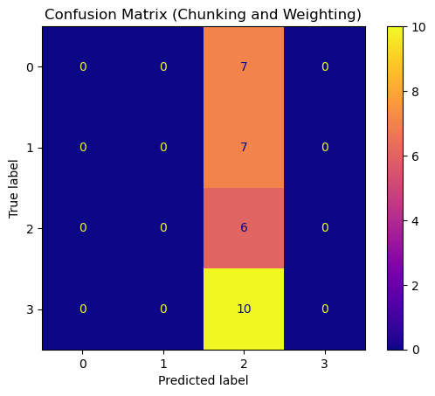
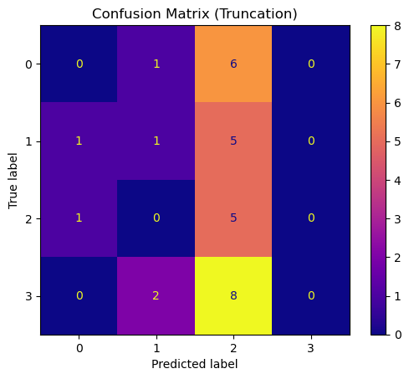
Can we predict the decade of a rom-com from its text? (LLM)
Using a fine tuned DistilBERT model trained on a custom dataset of 2,859 movie scripts
Accuracy: 20%
Accuracy: 20%

Slide 31

O
ur Questions Answered
Are recent romantic comedies more correlated with each other than those of the past?
Have romantic comedy scripts become less complex (in terms of vocabulary)?
Can the era of a romantic comedy be easily predicted based on aspects of the script?

Slide 32

O
riginal statement
or inspiring quote
— Credit or citation

Slide 33
Are recent romantic comedies more correlated with each other than those of the past?
Have romantic comedy scripts become less complex (in terms of vocabulary)?
Can the era of a romantic comedy be easily predicted based on aspects of the script?

Slide 34
T
opic or idea
Main point
Main point
A paragraph. Elaborate on what you want to discuss.
A paragraph. Elaborate on what you want to discuss.

Slide 35

T
opic or idea
A paragraph. Elaborate on what you want to discuss.

Slide 36
T
opic or idea
Column name | Column name | Column name | Column name | Column name

Slide 37
T
opic or idea
Main point
A paragraph. Elaborate on what you want to discuss.

Slide 38
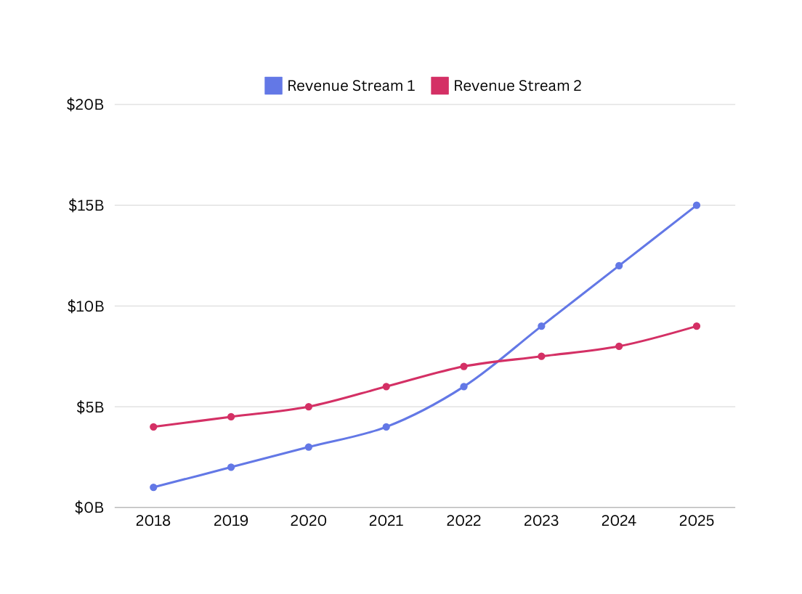
C
A subtitle. This should be a description different from the title.
hart title
$ billions in revenue
Context for the chart. How does it describe part-to-whole relationships and hierarchies? What factors might be contributing to the differences in allocation? What other observations are worth highlighting?

Slide 39

T
opic or idea
A paragraph. Elaborate on what you want to discuss.

Slide 40








R
P
esource
age
Use these in your presentation. Delete or hide this page before presenting.
Design Elements / Icons

Slide 41



C
redits
This presentation template is free for everyone to use, thanks to the following:
for the presentation template
Pexels, Pixabay
Happy designing!

Slide 42

R
P
esource
age
Find the magic in presenting. Select these keys while in Present mode. Delete or hide this page before presenting.
B
C
D
M
for blur
for confetti
for drumroll
for mic drop
O
Q
U
Any number from
0-9 for a timer
for bubbles
for quiet
for unveil

